Slide 1

Entrepreneurship ENT241
Name : Noraliya Farisha binti Mohammad Sha’rani
ID: AM1905005355
Section: 8

Slide 2


Company Background
Name : Solely Art My
Product : Digital art and stickers
Business platform : - Instagram
- Facebook Page
- Twitter
- Carousell
Username : solelyartmy
To purchase : https://docs.google.com/forms/d/e/1FAIpQLSdkqIzPxgTz8UmiYHTi0kJmbbUhQmZF11FhMxsBeAtAWTKULg/viewform
Email : solelyartmy@gmail.com

Slide 3
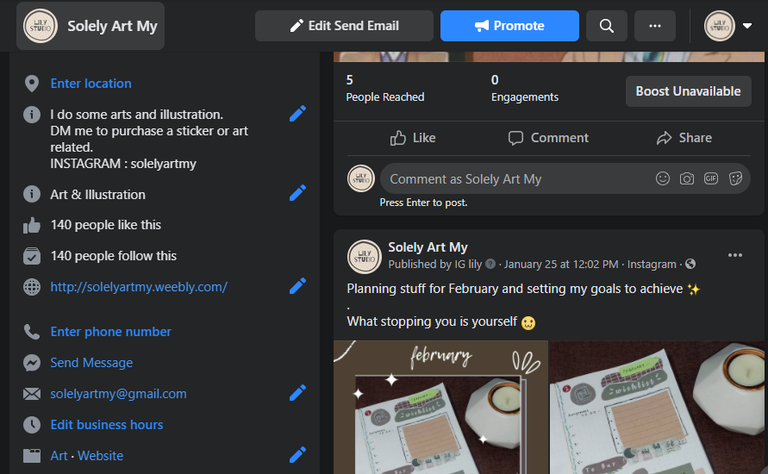
Facebook Page
https://www.facebook.com/solelyartmy/

Slide 4
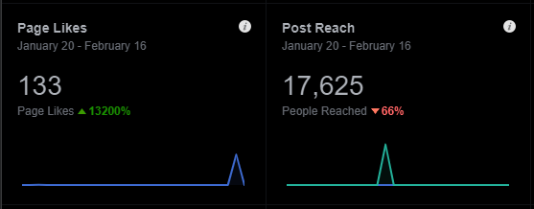
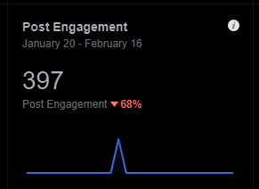
Facebook Insights

Slide 5
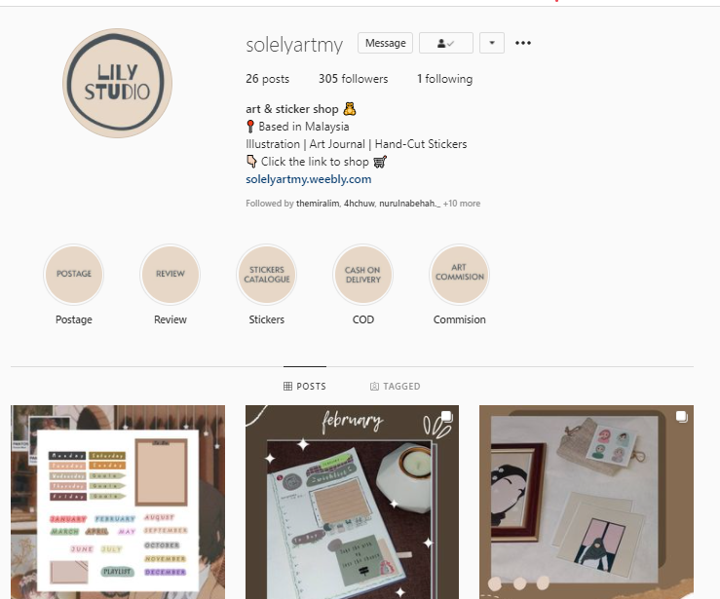
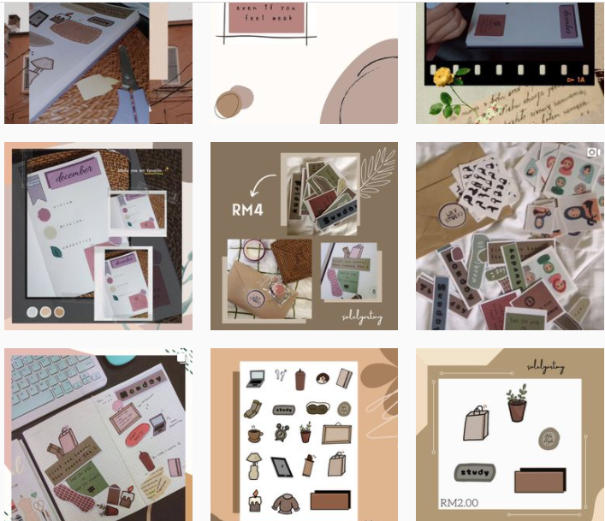
Instagram
https://instagram.com/solelyartmy

Slide 6
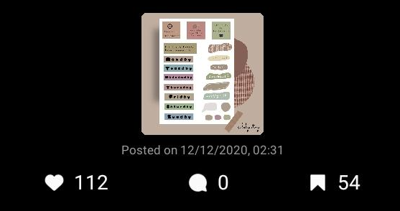
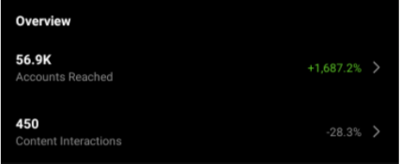
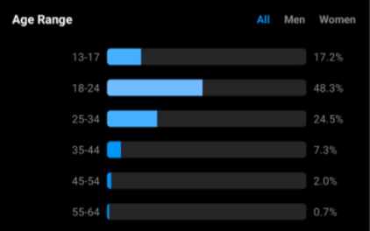
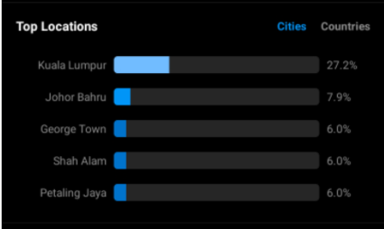
Instagram Insights

Slide 7
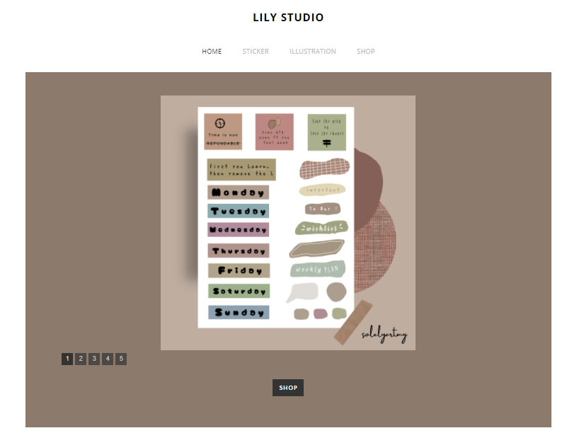
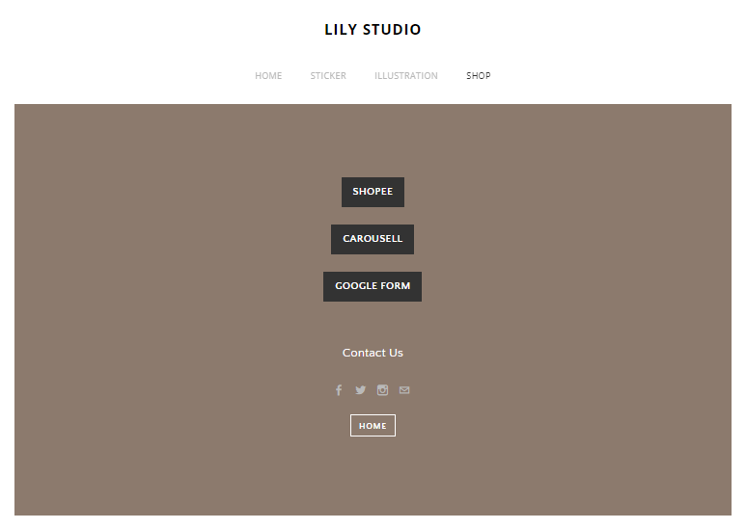
Website
https://solelyartmy.weebly.com/

Slide 8
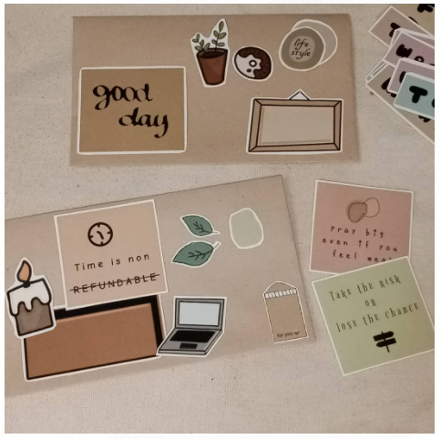
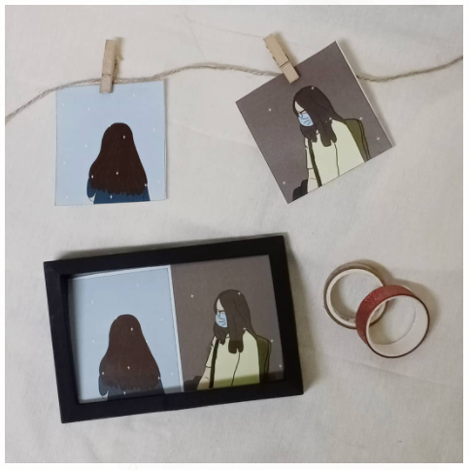
Product
Stickers Illustration

Slide 9
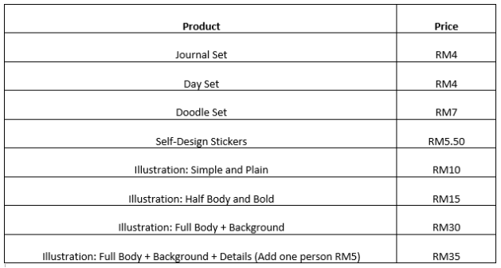
Price

Slide 10
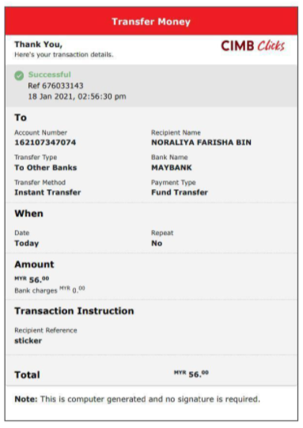
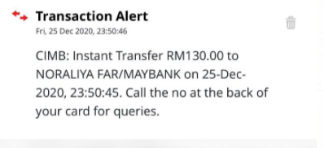
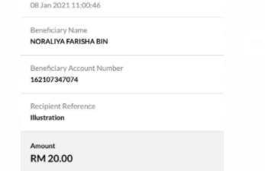
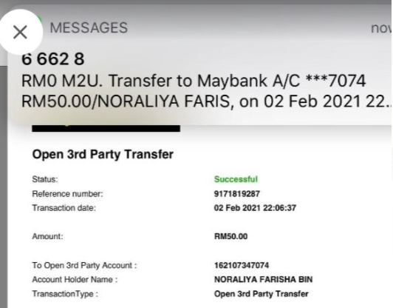
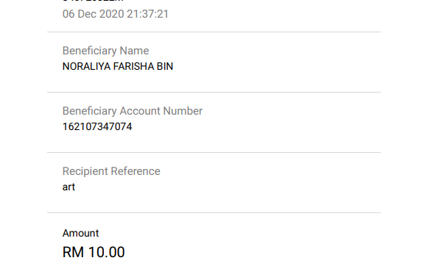
Sales
Target sales: RM50 (weekly) RM200 (monthly)
Total Sales December-February: RM754

Slide 11
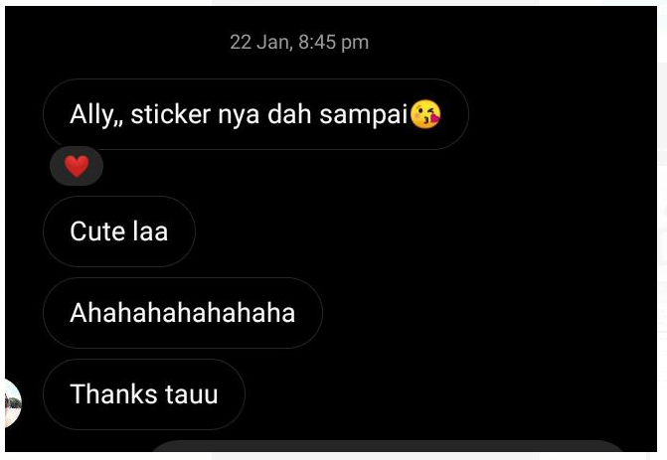
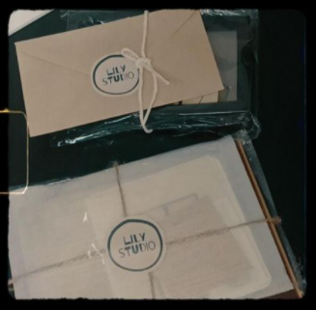
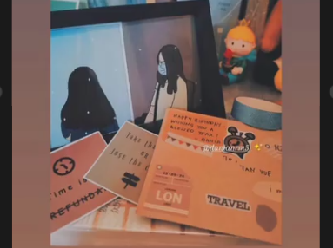
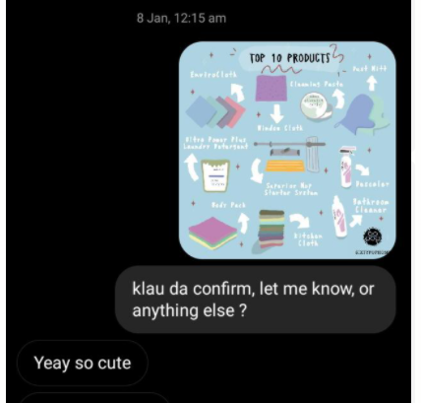
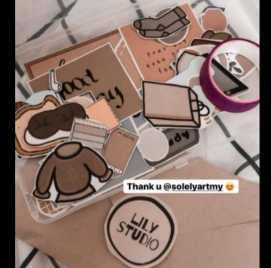
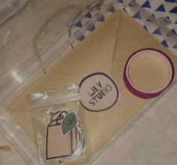
Feedback

